Slide 1
Buildup to stream segregation: physiology and statistics
Review of Micheyl et al, 2005; intro for Steele, Tranchina, & Rinzel
Sara Steele

Slide 2
Challenges for elucidating neural mechanisms of stream segregation
perceptual report vs. localized brain activity: can’t win ‘em all
stimuli that consistently evoke different percepts will also recruit different populations of sensory neurons
correlation vs causation: similar changes found as early as auditory brainstem as those found in A1 (Pressnitzer et al, 2008)

Slide 3
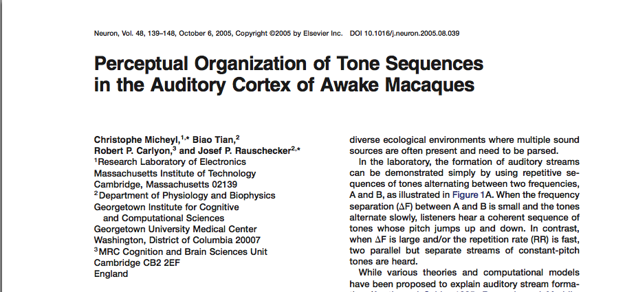
constant stimuli + buildup = good guess as to percept
use same stimuli for psychophysical (human) and electrophysiological (macaque) experiments

Slide 4
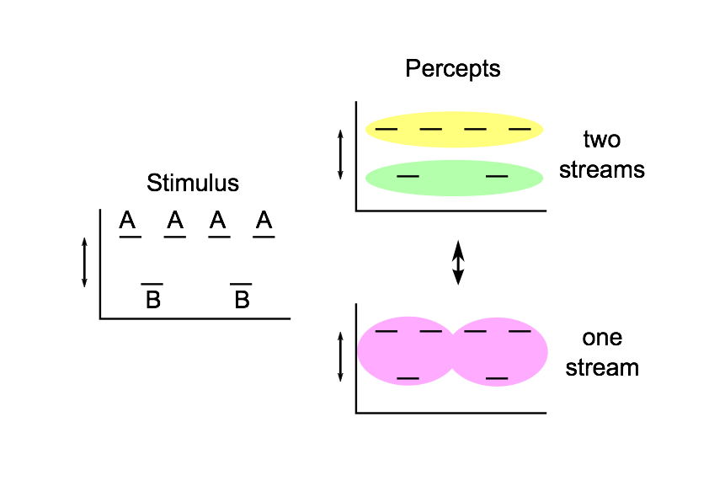
Stimuli
4 frequency separations: 1,3, 6, & 9 semitones
Absolute fq. of the A tone varied from 500 to 4000 Hz for humans
For monkeys, A tone set to be the best frequency (BF) of the neuron being recorded from. ~80% units BF between 500 & 4000 Hz.

Slide 5
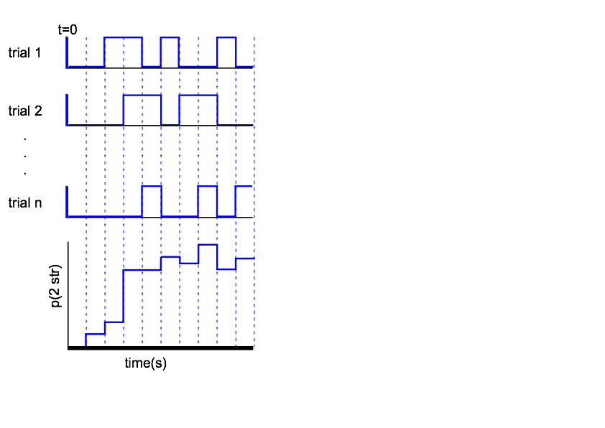
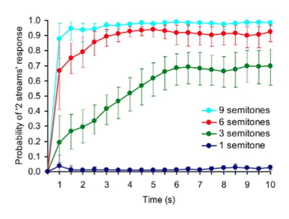
Constructing psychometric functions (human)
Nswitches
.23
.55
.9
.08

Slide 6
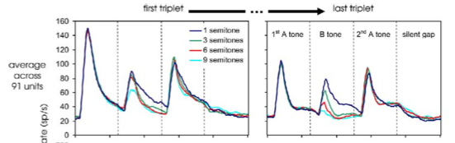
Neural responses
Spike rate (rel baseline)
2 effects:
lower response to B tones with higher dF --> selectivity, forward suppression
lower responses to last triplet than first --> habituation
BF
tone frequency (log)

Slide 7
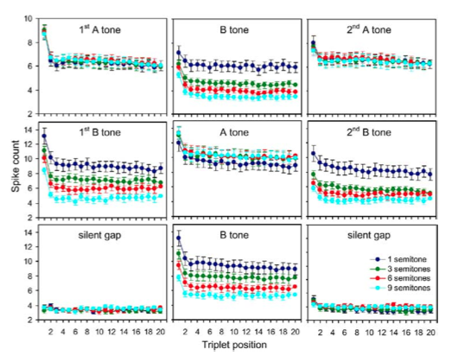
Spike counts: toward a neurometric function
habituation largest between first and second triplet
B tone responses released by absence of A tone (bottom)
A & B tone responses higher when A occurs less frequently

Slide 8
Neurometric function: Grouping by Coactivation + SDT
tone A
p(nSpikes = x)
spike counts from neuron “A”

Slide 9
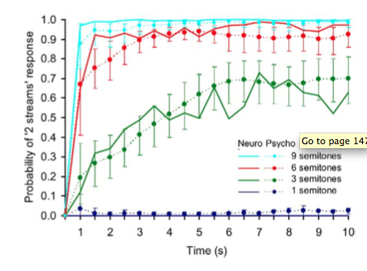

Slide 10
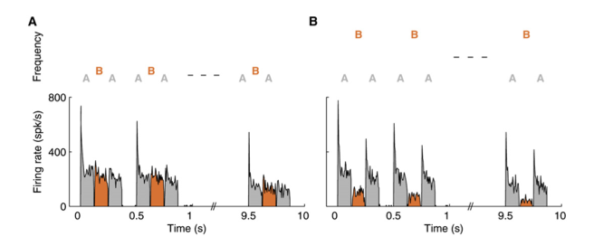
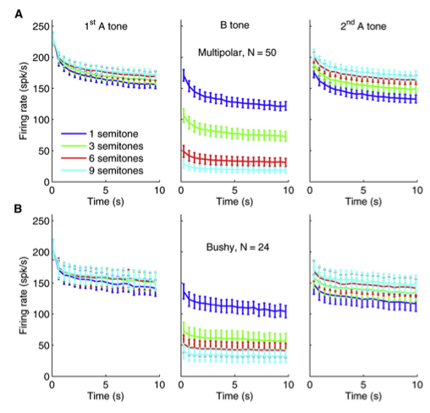
But what about alternations?
identical findings in auditory brain stem
accumulation of adaptation can explain integrated--> segregated switch, but not the switch back
can buildup be described in a framework that accounts for alternations?

Slide 11
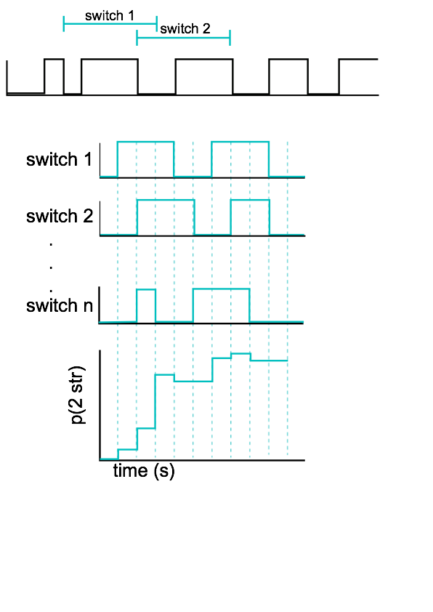
Constructing psychometric functions from long trials

Slide 12
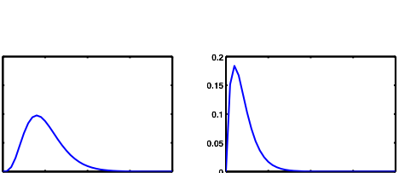
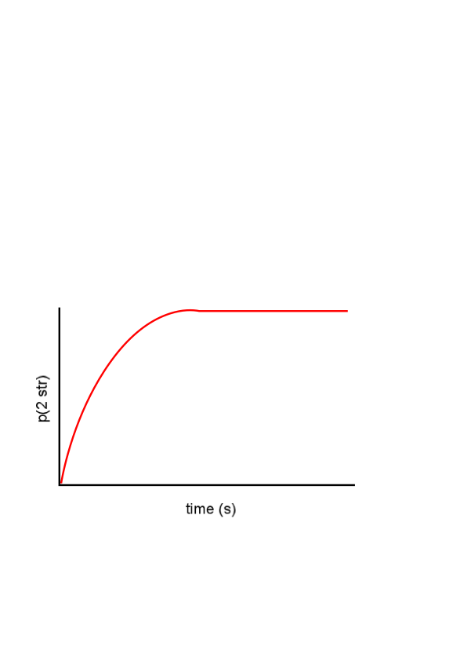
Alternating renewal process
A system alternates between two states, with known distributions of dwell times
The system is known to always start in a particular state
Distribution of percept durations
“1 stream”
“2 streams”
k1 (shape)
θ1 (scale)
k2
θ2
p(duration=x)
duration (s)
Alternating renewal process model (ARP)
p(2 str|t) =
f(k1,θ2,k2,θ2
Distribution of percept durations
“1 stream”
“2 streams”
k1 (shape)
θ1 (scale)
k2
θ2
p(duration=x)
duration (s)
p(2 str|t) =
f(k1,θ2,k2,θ2

Slide 13
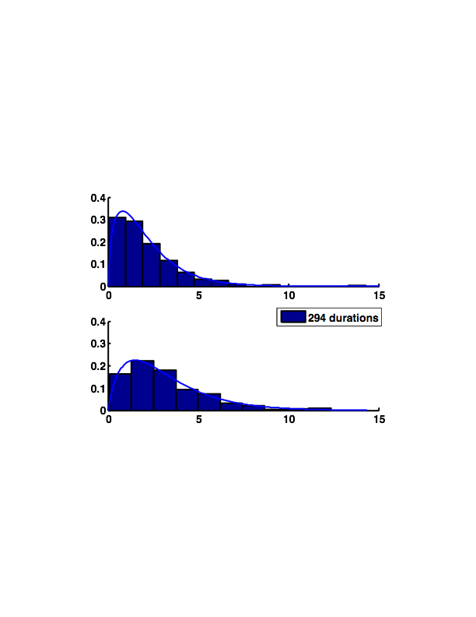
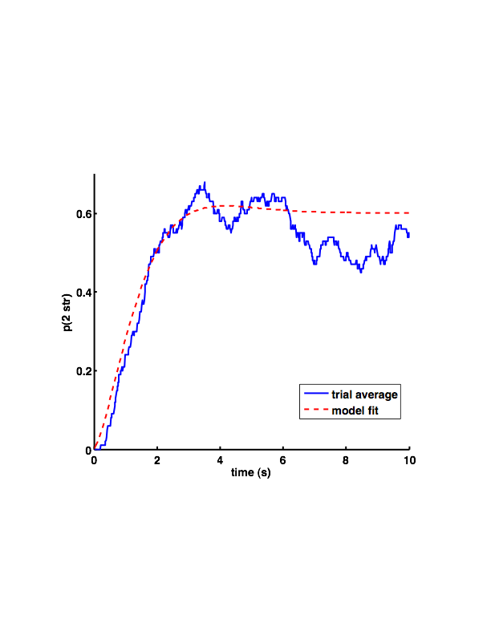
Short trials- like Micheyl et al
k=1.60
θ=1.34
k=1.86
θ=1.74

Slide 14
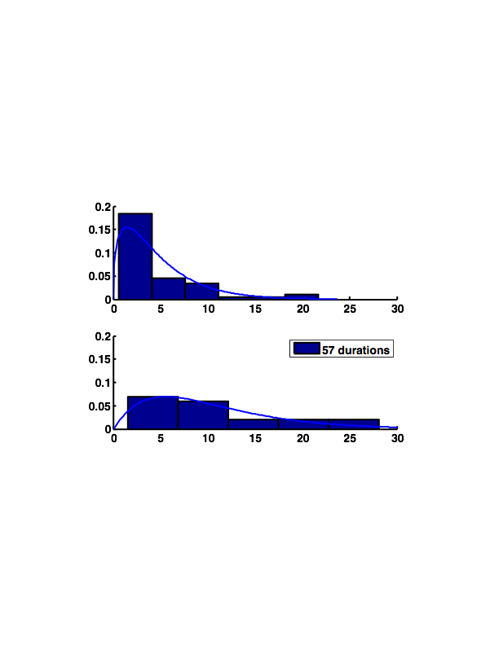
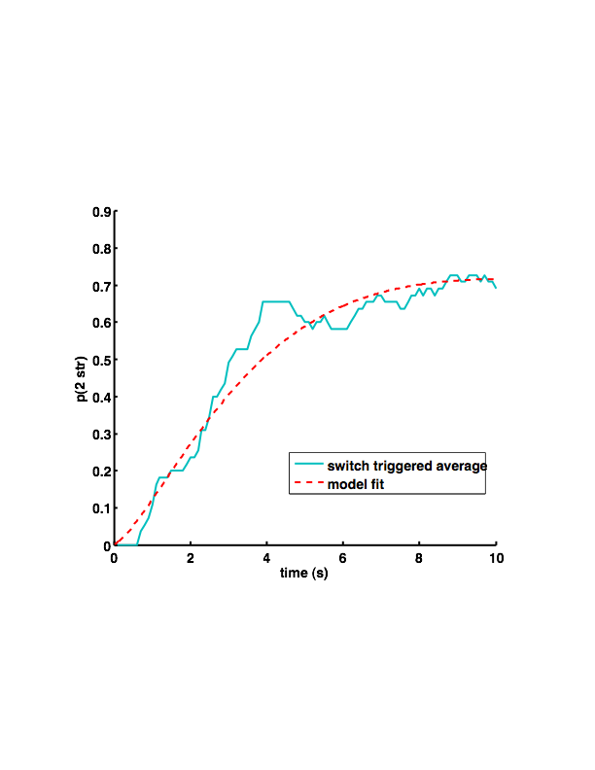
Long trials- many alternations
r = .29

Slide 15
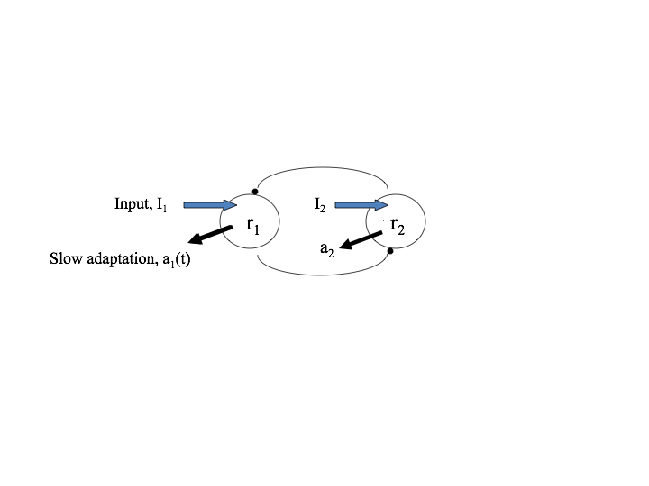
Neural networks that achieve alternation
Feedforward architecture explains coh-->seg, but not alternations
Require competition between neural populations to achieve alternations

Slide 16
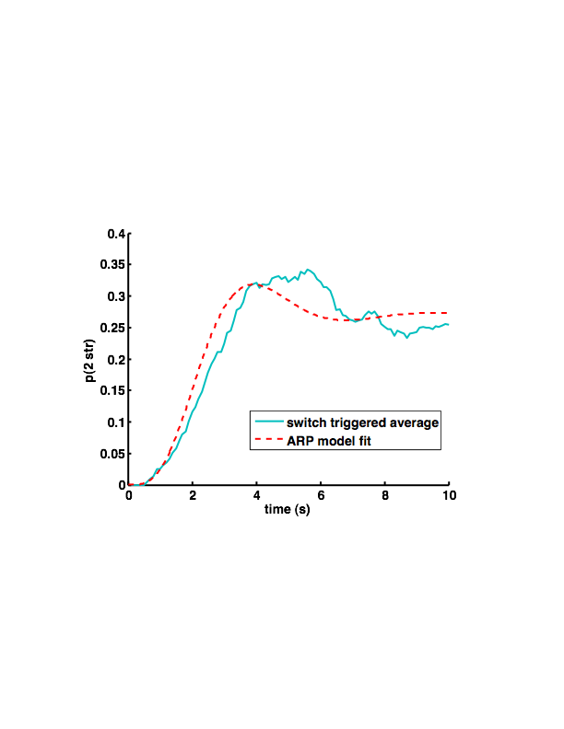
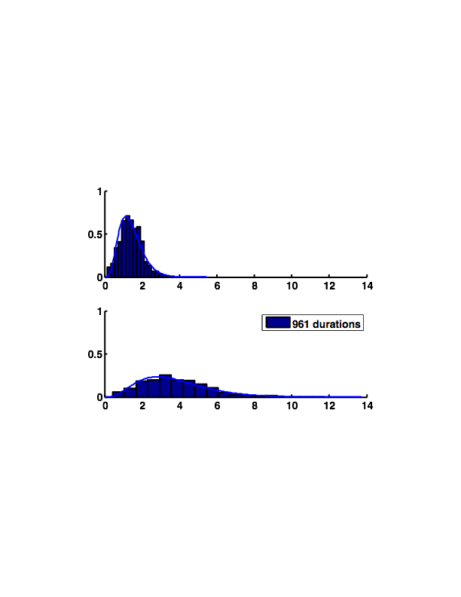
Competition model simulations
k=5.21
θ=0.27
k=4.02
θ=0.94

